Slide 1


Capstone Project 2 NYC Taxi Trip Prediction
By
Sachin pandey
Datascience intern, Almabetter

Slide 2
Introduction
This dataset is about the predicting the duration of the any trip in the New York city.
In modern times there is a huge challenge of automation and it is very important to understand the data about any taxi very thoroughly.
Like even in India we have various taxi booking applications and it is very important for the distributor to understand that when the taxi would be free for the next ride.
We can have many challenges across the data or the real life to understand the data and implement it with the domain knowledge.
Meanwhile we shall try to optimize our model so far by doing some feature engineering across the data.
With this let’s get to the problem statement .

Slide 3
Problem Statement
Our task is to build a model that predicts the total ride duration of taxi trips in New- York city.
This dataset is released by the NYC taxi Limousine Commission, which includes many features like pickup time, geo coordinates, number of passengers and many other variables.
Also we shall try to engineer some new features based on the old ones and try to implement it in the model prediction.
So with this we applied several data analysis tools and get few insights from the data and trained our model in several algorithms.

Slide 4
Data Information
ID
Vendor_ID
Pickup_datetime
Dropoff_datetime
Passenger count
Pickup_Longitude
Pickup_Latitude
Pickup_Latitude
Dropoff_Longitude
Dropoff_Latitude
Store_and_fwd_flag
Trip Duration

Slide 5
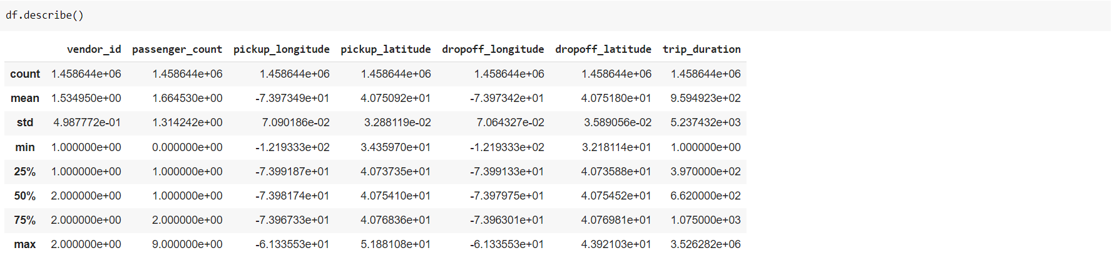
Data Information

Slide 6
Index
Univariate Analysis
Bivariate analysis
Correlation Heatmap for user data
Model Training on various algorithms
Challenged Faced
Conclusion

Slide 7
Univariate Analysis
In univariate analysis we shall analyse about the various columns and understand their data.
Generally while doing univariate analysis we try to understand these few important points, like calculation of frequency, central tendency and dispersion of the data.
Below are some data about univariate.
Passenger count
Number of pickups and drop off each week and their distribution.
Distribution of store and forward flag and
Distribution of Trip duration, drop off latitude and longitude.
Distribution of pickup longitude and latitude.
Distribution of the vendor id.

Slide 8
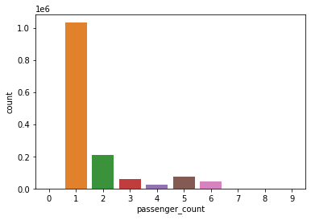
Passenger Count
In this column we the data about the number of passengers who travelled in the taxi.
We can see the the mostly cab was taken in solo as per the graph of passenger count.
However we have few cases where the passenger count increased to 9 person per head.
In the further analysis we shall treat it like an outlier as it won’t contribute much in the data, besides messing with the model.

Slide 9
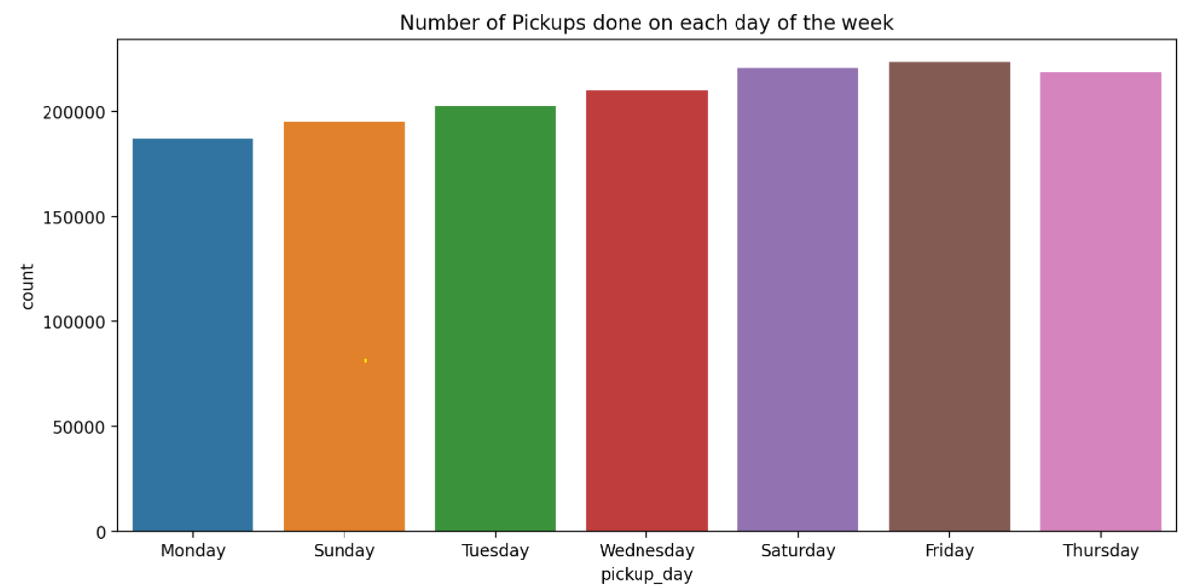
Number of pickups in a week
This graph shows the number of number of pickups done in the each day of the week.
We can see the highest number of pickups were done on Friday and Saturday.
This can be due the weekend as people often tend to travel in the weekends.
Also we shall analyse whether the number of drop offs were done in the same way as the pickups during the weekends.

Slide 10
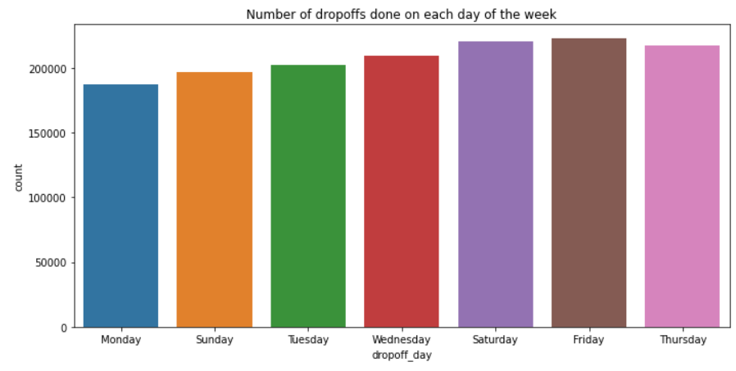
Number of drop offs in a week
This graph shows the number of number of drop offs done in the each day of the week.
We can see the highest number of drop offs were done on Friday and Saturday similar to the pickups.
This can be due the weekend as people often tend to travel in the weekends and they headed back the same day.
Also there were the cases when people hadn’t return as the return count was low and this might be due to some relatives and all.

Slide 11
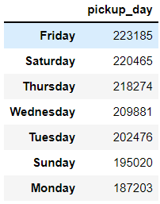
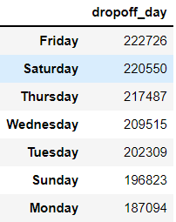
Number of drop offs in a week
Here in the data we can see the number of drop offs is bit lower than the pick ups.

Slide 12
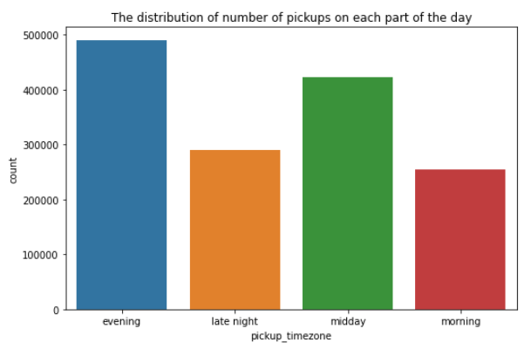
Distribution of pickup and dropoff hours
This graph shows the distribution of the pickup hours in each part of the day.
We can see that the most number of pickups are done in the evening.
The count is average for the pickups in the midday.
However the lowest number of pickups were done in the Morning,

Slide 13
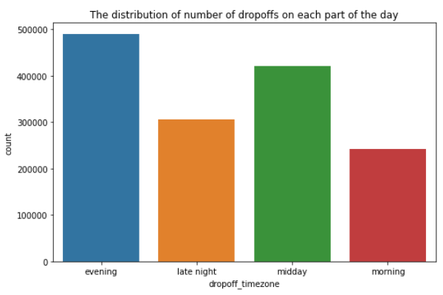
Distribution of pickup and dropoff hours
This graph shows the distribution of the drop off hours in each part of the day.
We can see that the most number of drop offs were done in the evening same as the count of pick ups.
The count of number of drop offs were lowest in the morning as similar to pickups.

Slide 14
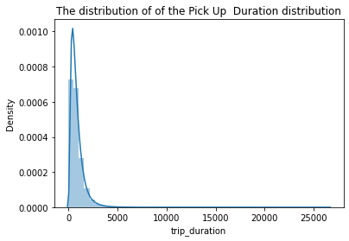
Distribution of trip duration
This graph shows the distribution of trip duration.
We can see that the graph is highly skewed to the right.
This means that we have outliers in the trip duration which has to be removed.

Slide 15
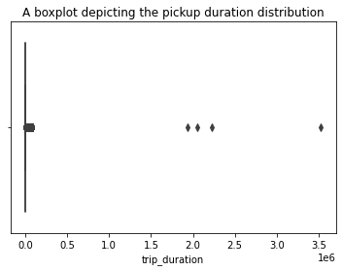
Distribution of trip duration
Looking at the boxplot we can see that total four outliers are present which will be removed before training the model.
These counts represent that the customer travelled for approx 900+ consecutive hours which is not possible at all even if we consider that as domain knowledge.
We have total 4 outliers where the time duration ranged between 450 - 1000 hr per trip duration.

Slide 16
Bivariate analysis
Bivariate analysis is one of the simplest form of statistical analysis.
It involves the analysis of two features to determine the empirical relationship between them.
It can be helpful in testing the simple hypothesis of relation. Below are the some columns where we have done bivariate analysis.
Trip duration and day of the week.
Trip duration and hours.
Graphical location and duration.
Distance and trip duration.
Feature Engineering
Correlation heatmap
Model training and testing

Slide 17
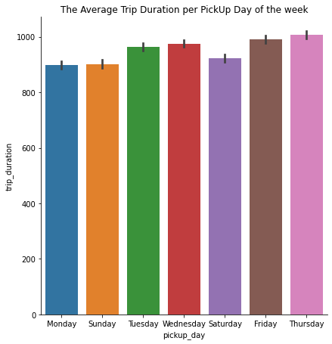
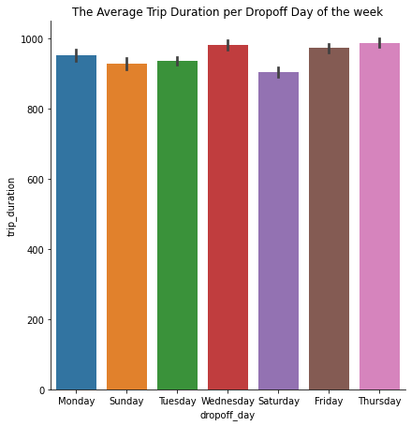
Trip duration vs pickup day

Slide 18
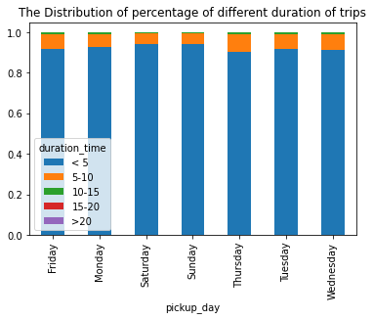
Trip duration vs pickup day
This graph denote the average estimate of a trip for each day of the week.
The error bars provides some indication of the uncertainty around that estimate.
Thus the highest average time taken to complete the trip is on Thursday, while Saturday and Sunday takes the least time.
We must also take the consideration of the percentage of short, Medium and long trips taken on each day.

Slide 19
Trip duration vs pickup day
The graph shows a percentage distribution of the trips of different duration within each day of the week.
This does not give much insights as the number of trips within 0–5 hours range is much larger for all the days,
Let.s look at the percentage of only longer trips (with duration time > 5 hours)

Slide 20
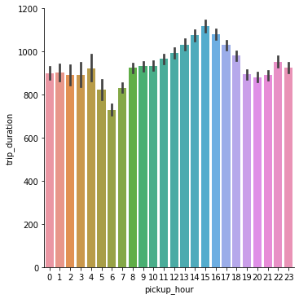
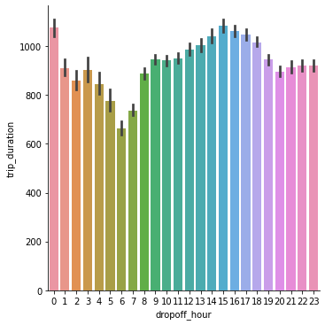
Trip duration vs pickup hour
The highest average time taken to complete a trip are for trips started in midday(between 14 and 17 hours) and the least are the ones taken in the early morning(between 6–7 hours)

Slide 21
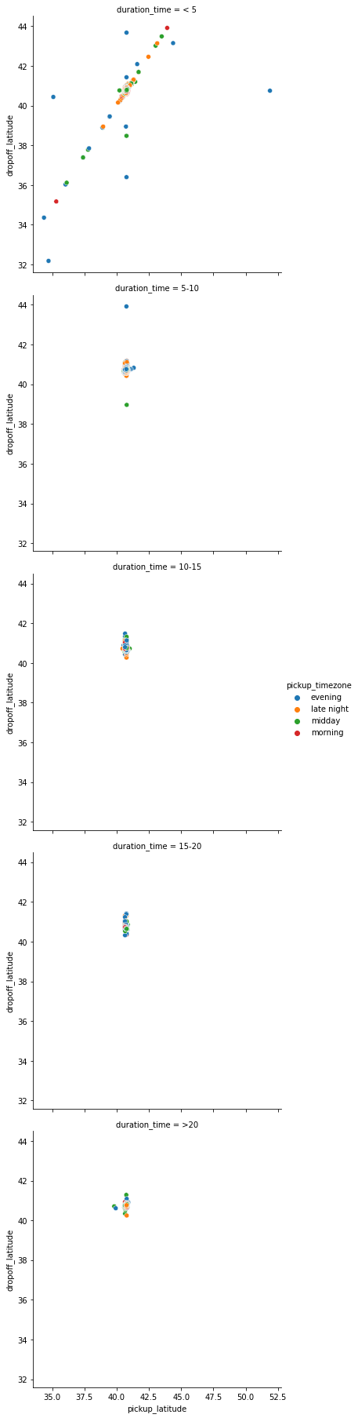
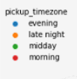
Geographical Location and duration

Slide 22
Geographical Location and duration

Slide 23
Geographical Location and duration
Here’s what we see:
For shorter trips (<5 hours), the pickup and dropoff latitude is more or less evenly distributed between 30 ° and 40 °
For longer trips(>5 hours ) the pickup and dropoff latitude is all concentrated between 40 ° and 42 ° degrees.

Slide 24
Conclusion from the trip duration plot
Trip Duration varies a lot ranging from few seconds to more than 900 hours.
Most trips are taken on Friday , Saturday and Thursday.
The average duration of a trip is most on Thursday and Friday as trips longer than 5 hours are mostly taken in these days.
The average duration of trips started in between 14 hours and 17 hours is the largest.
Vendor 2 mostly provides the longer trips.
The long duration trips(> 5 hours) are mostly concentrated with their pickup region near (40 °,75 °) to (42°,75°).

Slide 25
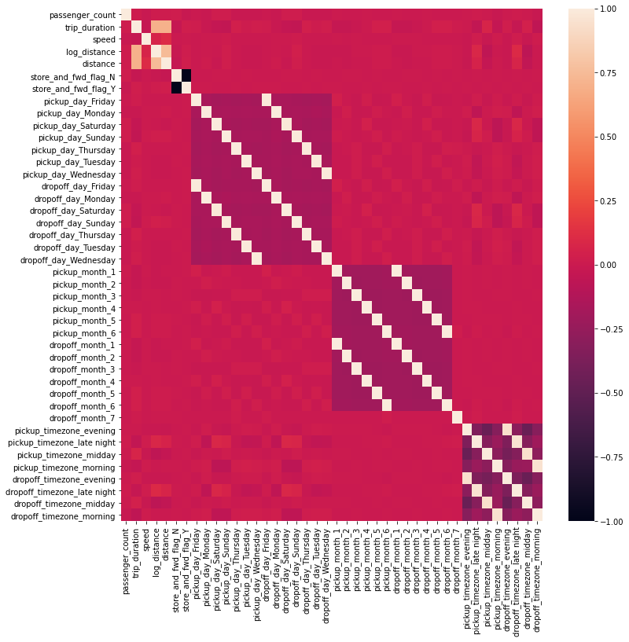
Correlation Heatmap
Thus we see that some features has high correlation with other features and some are not correlated at all.
First we will create a model with the mean of trip duration as the prediction.
Then we will create a baseline model with only distance and it has a correlation > 5 with trip_duration.
Next, we will choose the other features which are positively correlated with trip_duration and create the third model.
We will split our data into 2 parts.
The first part we will use to train our data and the 2nd part will be used for testing.

Slide 26
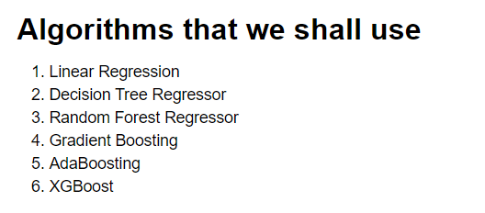
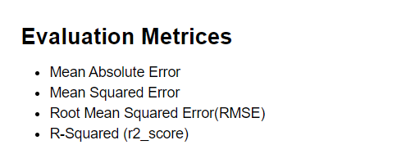
Algorithms and evaluation metrics

Slide 27
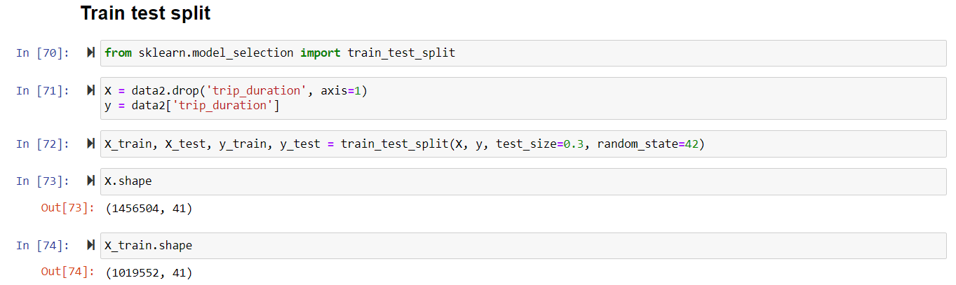
Splitting the data details
After the feature engineering and EDA we splitted the data into training and testing by 70:30

Slide 28
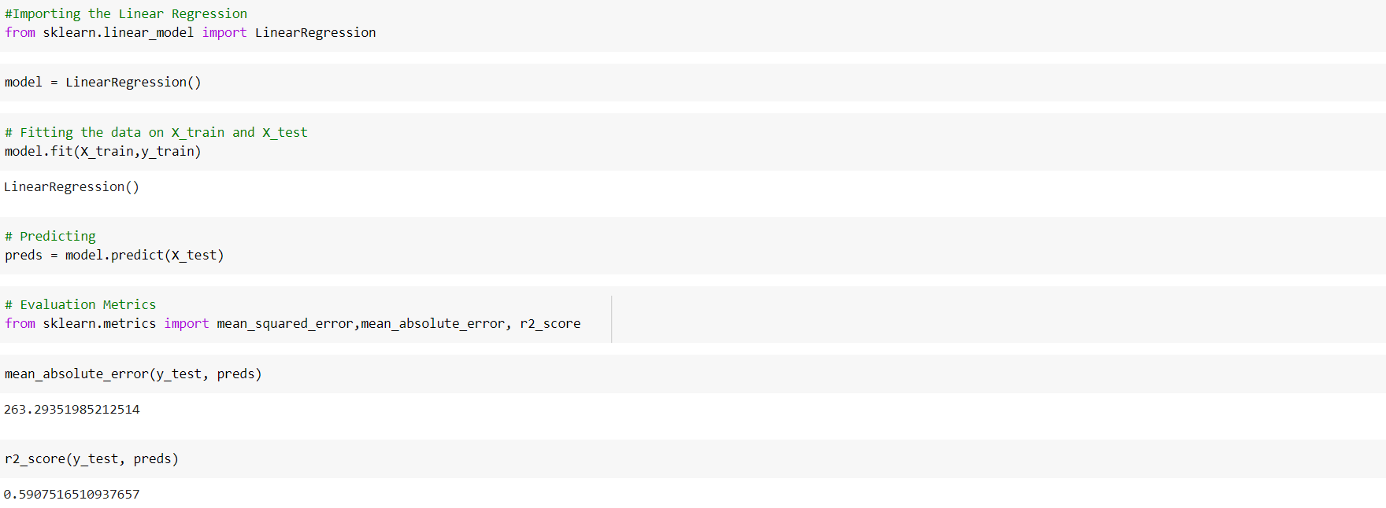
1. Linear Regression
Linear regression is used for finding linear relationship between target and one or more predictors.
There are two types of linear regression- Simple and Multiple.
Here the Linear Regression model performed relatively well.
The r2_score of 0.59 is also accepted.
Yet we have MAE, MSE very high so let's check with other algorithms also.

Slide 29
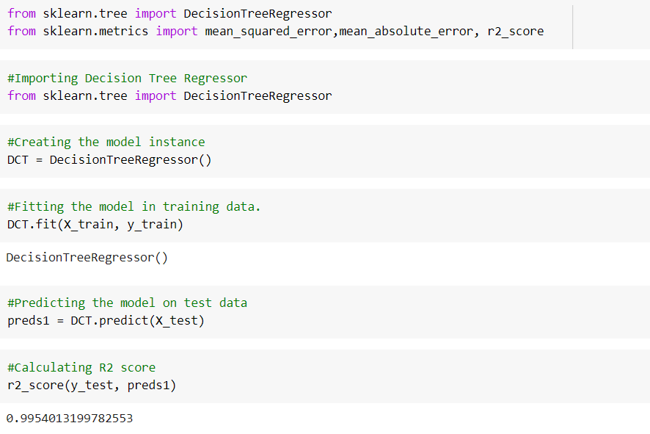

2. Decision Tree
Decision Tree is a supervised learning technique that can be used for classification and regression problems.
It uses CART(Classification and Regression Tree) algorithm and finds the best attribute using ASM(Attribute Selection Measure).
The Decision Tree model performed extremely well as we can see the RMSE error of 43.67
The r2_score of 0.99 is extremely well as it ranged between 0 -1 .
Yet let’s check with other models also.

Slide 30
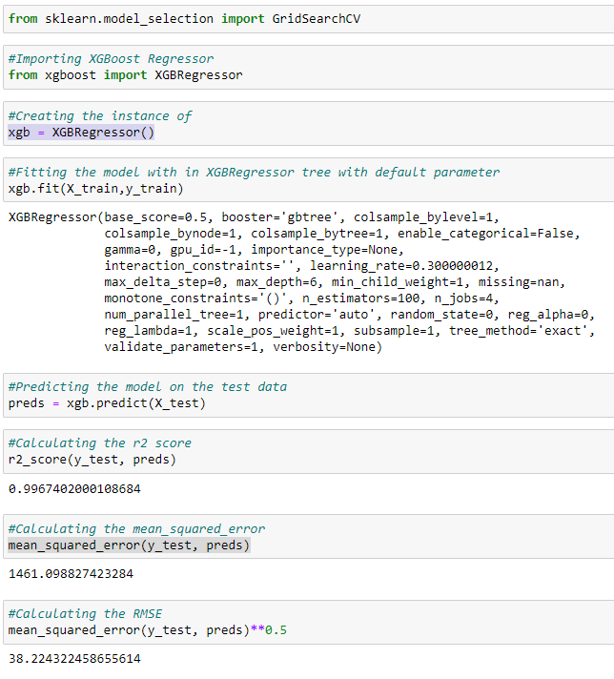
3. XGBoost Regressor
XGBoost is a scalable and highly accurate implementation of Gradient Boosting that pushed the limit of computing power, being built largely for energising .
It implements machine learning algorithms under the Gradient Boosting framework.
XGBoost provides a parallel tree boosting (also known as GBDT, GBM) that solve many data science problems in a fast and accurate way
The r2_score of 0.997 is extremely well as it ranged between 0 -1 .
And just like Decision Tree, XGBoost performed the best.

Slide 31
Major Challenges
Feature Engineering
Model Selection
Hyperparameter Tuning
Platform for fast computation.
Model optimization manually

Slide 32
Conclusion
Trip Duration varies a lot ranging from few seconds to more than 20 hours also some are going from 528 Hours to 972 Hours, possibly Outliers.
Observed Vendor 2 taxi service provider is most Frequently used by New Yorkers.
Trip duration is generally longer for trips whose flag was not stored.
There were few trips with Zero Passengers and few trips with 7,8 and 9 passengers and Most number of trips are done by single or double passengers.
Few Trip duration has covered 0 Km distance.
Trip duration is the maximum around 3 pm and the lowest around 6 am.
Trip duration is the longest on Thursdays closely followed by Fridays.
From February, we can see trip duration rising every month also significant drop in the Taxi trip count as month end approach.
for shorter trips (<5 hours), the pickup and dropoff latitude is more or less evenly distributed between 30 ° and 40 °
for longer trips(>5 hours ) the pickup and dropoff latitude is all concentrated between 40 ° and 42 ° degrees.
The long duration trips(> 5 hours) are mostly concentrated with their pickup region near (40 °,75 °) to (42°,75°)

Slide 33
THANK YOU

